Slide 1
Airline Booking System
CSYE 7374 - Design Patterns

Slide 2
Team Members & Contributions
Hiral Rajesh Nagda - 001560027 (Decorator Pattern)
Jyoti Vaswani - 001005711 (Adapter Pattern)
Aravind Polepeddi - 002102800 (Strategy Pattern)
Vraj Himanshu Reshamdalal - 002927484 (State Pattern)
Jingru Xiang - 001586653 (Builder Pattern)
Venkteshprasad Maya Rao - 001087357 (Singleton, Factory & Facade Patterns)

Slide 3
Design Patterns Implemented
Singleton
Factory
Builder
Facade
Strategy
Decorator
Adapter
State
Future Scope: Command, Observable & Prototype

Slide 4
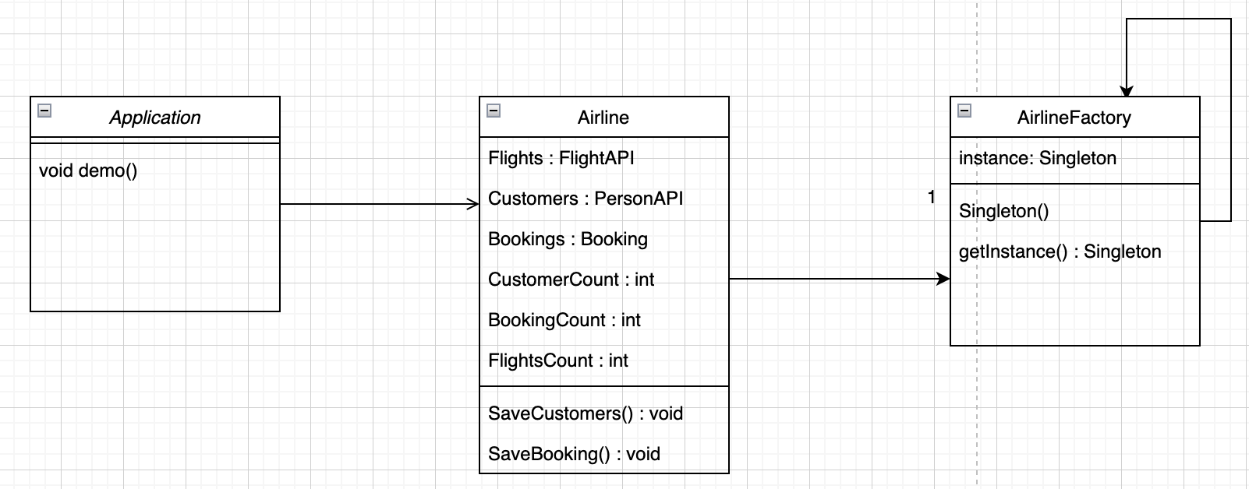
Singleton + Factory
The main method contains the demo method.
Airline object is created in demo method which gets its airline object from AirlineFactory
The AirlineFactory implements a eager singleton which produces the Airline object

Slide 5
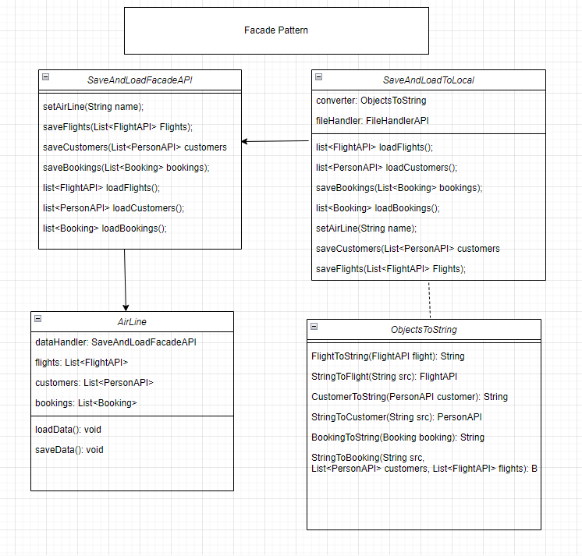
Facade
Complexities of saving and loading data during program start/stop are abstracted from user.
Different methods of saving and loading can be done simply by implementing SaveAndLoadFacadeAPI. Project has one implementation to save/load into csv files.
Instance of SaveAndLoadFacadeAPI implementation is composed in AirLine object.

Slide 6
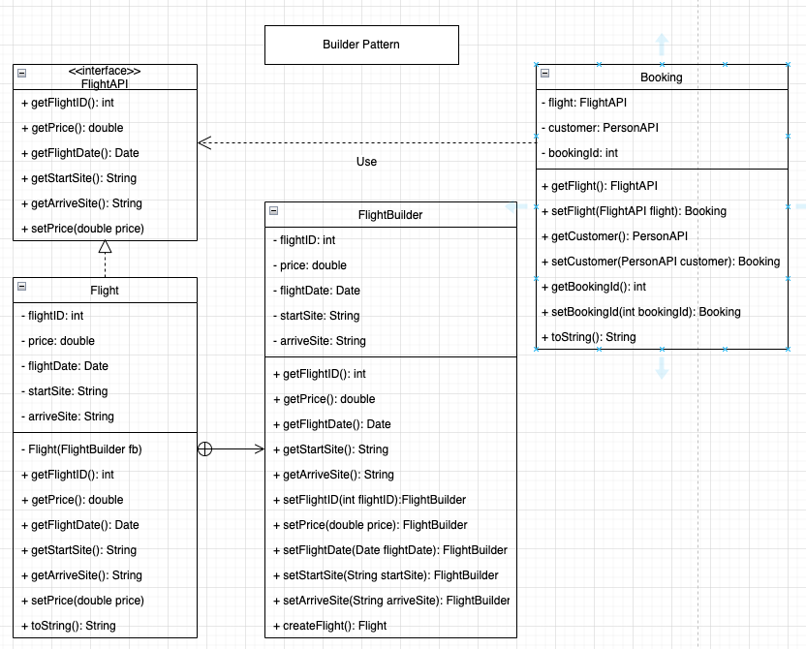
Builder
Flight class delegates object creation to FlightBuilder class, with which the same construction process can create different representations, making it easier to extend and vary flights’ internal representations.
Flight object is finally created by createFlight() method.

Slide 7
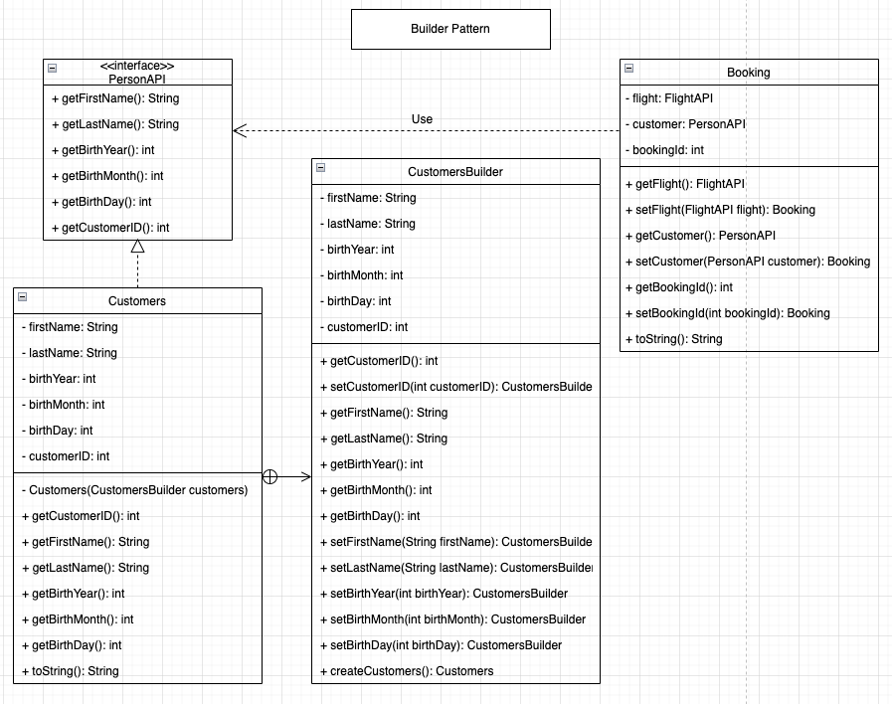
Builder
PersonAPI provides an interface for different classes to implement. If to add subscribers with Observable Pattern in the future, the Subscribers class can also implement PersonAPI.
Customers class delegates object creation to CustomersBuilder class to help extend and vary customers’ internal representations.
Customers object is finally created by createCustomers() method.

Slide 8
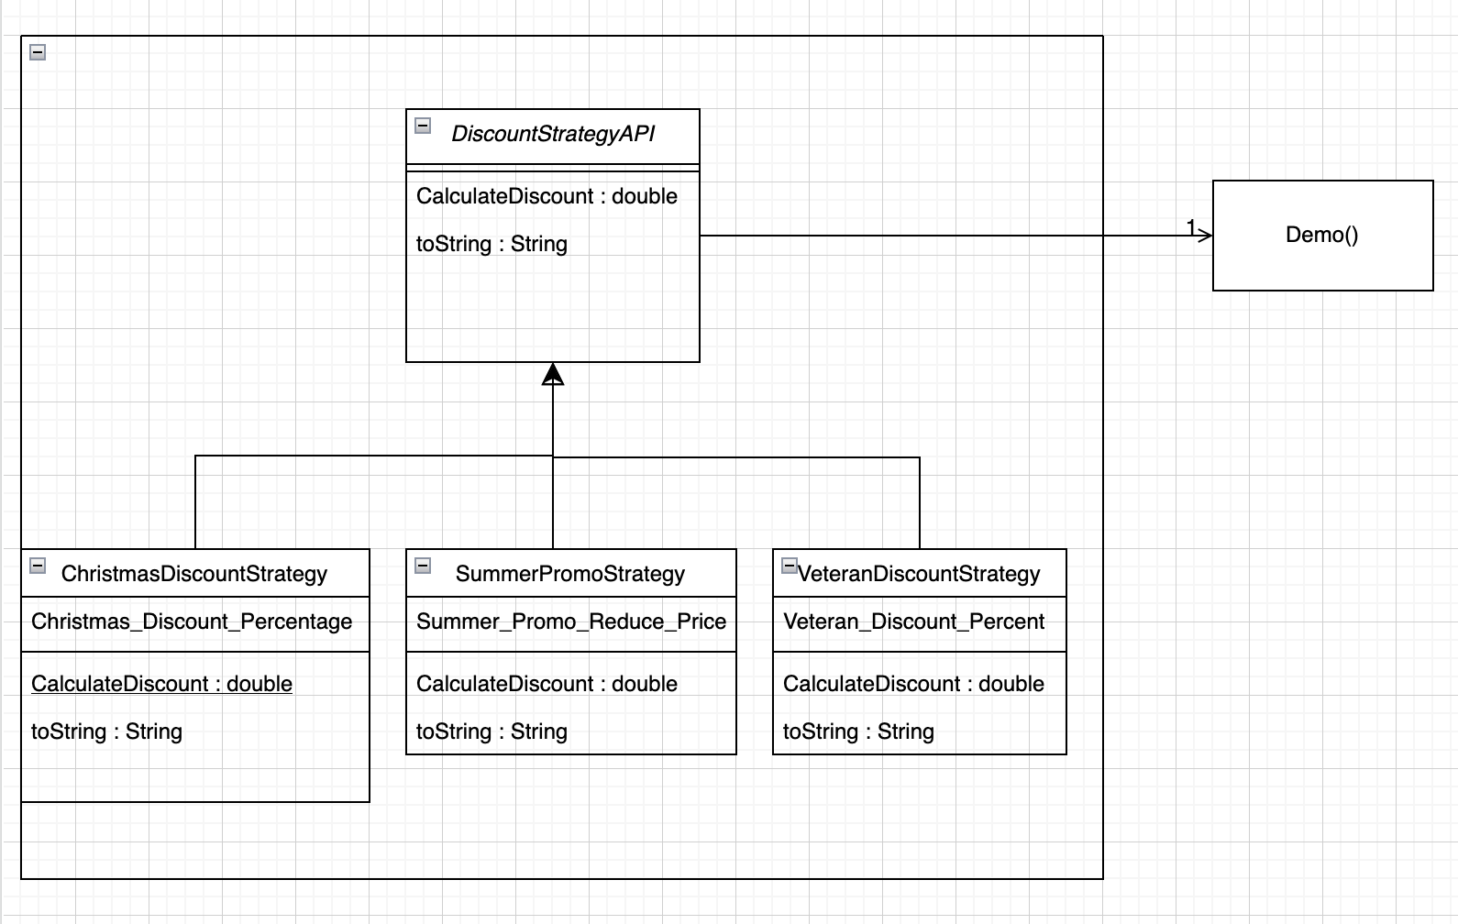
Strategy
The family of Discount Strategy Algorithms are interchangeable and the DiscountStrategyAPI specified by super class for abstraction
The airline price is passed as an argument for the CalulateDiscount() function which applies the percentage and return the discounted price
The strategy can be changed at runtime

Slide 9
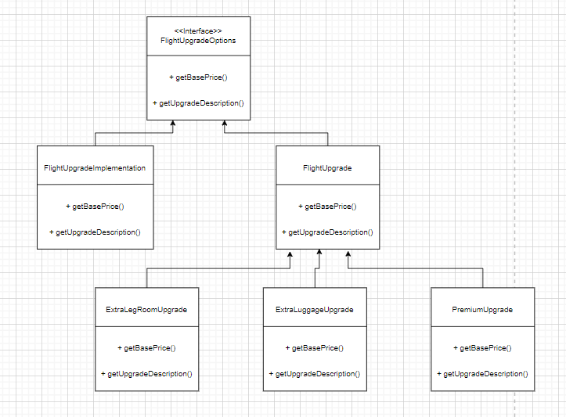
Decorator
FlightUpgradeOptions Interface to define methods to be overridden by decorators implementing it.
Instance of FlightUpgrade has the base price and description and that it passed to decorator methods for modifications
FlightUpgradeImplementation gets the base price and description.
Decorators:
-ExtraLegRoom
-ExtraLuggage
-PremiumUpgrade

Slide 10
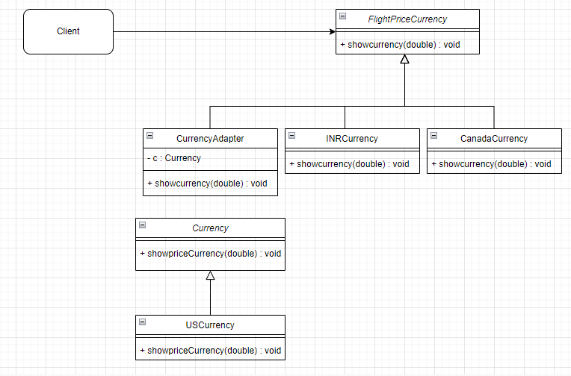
Adapter
Client can view flight prices in any of the currencies - INR, Canadian dollars or US dollars
CurrencyAdapter HAS-A object of Currency (interface) to be adapted
CurrencyAdapter hides use of adapted (Legacy API) code that provides flight prices in USDollars

Slide 11
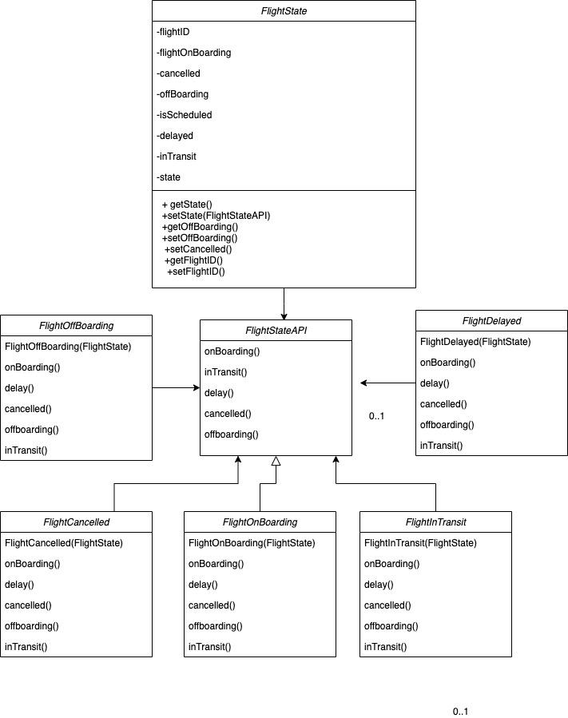
State
Flight state object changes its internal behaviour based on the internal states of the flight.
FlightStateAPI declares the methods that need to be implemented by each state of the Flight.
The states of the flight are:
Scheduled, OnBoarding, InTransit, OffBoarding, Delayed, Cancelled.

Slide 12
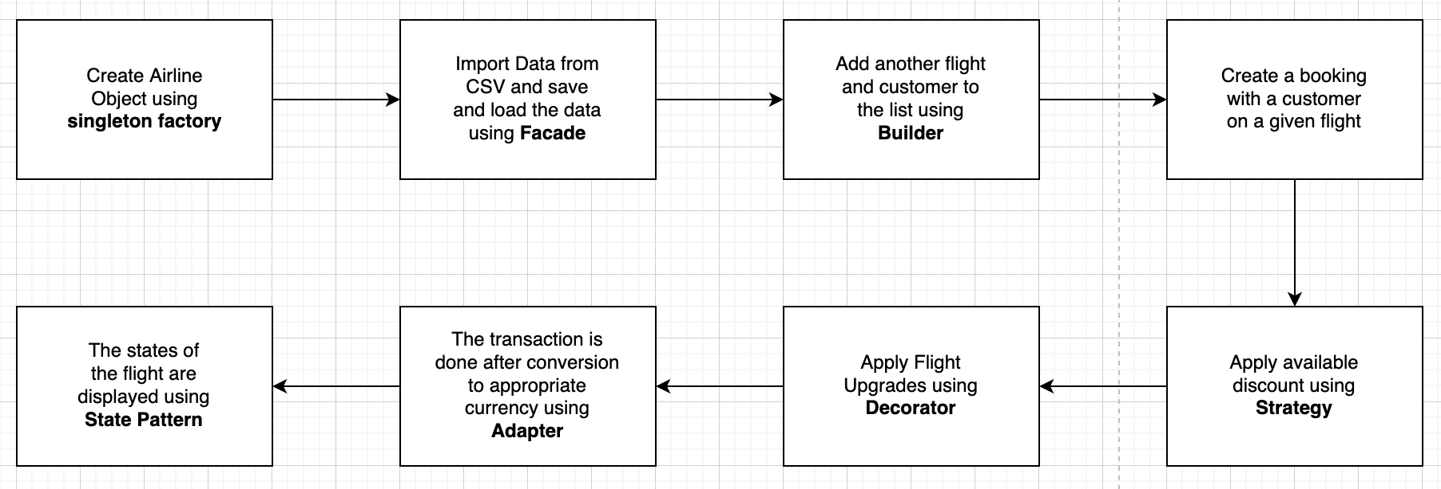
Program Flow

Slide 13
Future Scope
Observable: Observable Pattern can help to design the push contents for customers to subscribe. Suppose there is any change in flight number, departure or arrival time, and airline alerts. In that case, subscribers can be the observers to receive push content, and airline is the only one observable.
Prototype: Devise a quick order function using Prototype Pattern. Same customers who want to place an order with same flight number, same depart and arrive time in different date can click the ‘quick order’ button to clone history order and choose the new date without filling all blanks as a new order.
Command: Deploy Command Pattern to encapsulate every single user action as a Command and write it to a log file.

